Slide 1
FILES AND EXCEPTIONS

Slide 2
WORKING OF OPEN() FUNCTION
We use open () function in Python to open a file in read or write mode.
So, the syntax being: open(filename, mode). There are three kinds of mode, that Python provides and how files can be opened:
“ r “, for reading.
“ w “, for writing.
“ a “, for appending.
“ r+ “, for both reading and writing
The mode argument is not mandatory. If not passed, then Python will assume it to be “ r ” by default.

Slide 3
FILE MODES IN PYTHON
Mode | Description
'r' | This is the default mode. It Opens file for reading.
'w' | This Mode Opens file for writing. If file does not exist, it creates a new file. If file exists it truncates the file.
'x' | Creates a new file. If file already exists, the operation fails.
'a' | Open file in append mode. If file does not exist, it creates a new file.
't' | This is the default mode. It opens in text mode.
'b' | This opens in binary mode.
‘r+' | This will open a file for reading and writing (updating)

Slide 4
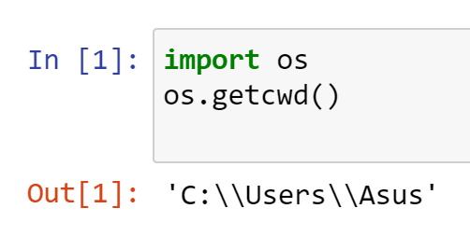
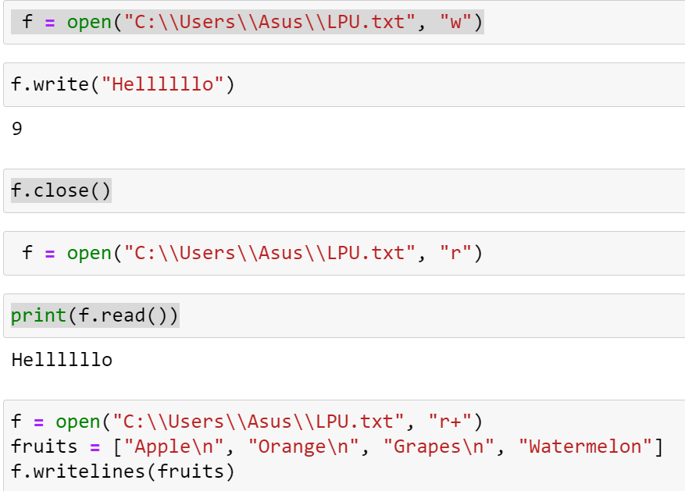
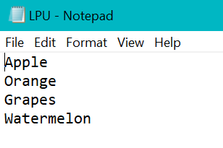

Slide 5
FILES
To open a ﬁle, you specify its name and indicate whether you want to read or write
>>> f = open("test.txt","w")
>>> print (f)
<open file ’test.txt’, mode ’w’ at fe820>
    First argument: Name of the ﬁle
    Second argument: mode (“r” for Read/”w” for Write)
If there is no ﬁle named test.txt, it will be created. If there already is one, it will be replaced by the ﬁle we are writing.
If we try to open a ﬁle that doesn’t exist, we get an error:
>>> f = open("test.cat","r")
IOError: [Errno 2] No such file or directory: ’test.cat’

Slide 6
WRITING DATA
write() is used to write a string .
writelines() method is used to write a list of strings
To put data in the ﬁle we invoke the write method on the ﬁle object with w
>>> f = open("test.txt","w")
>>> f.write("Now is the time")
>>> f.write("to close the file")
Closing the ﬁle tells the system that we are done writing and makes the ﬁle available for reading
>>> f.close()

Slide 7
fo = open("D:/pyt.txt", "r")
fo.read()
o/p: 'Hello\nHru\nI AM PYTHON‘

Slide 8
fruits = ["Apple\n", "Orange\n", "Grapes\n", "Watermelon"]
f = open("add.txt", "w")
f.writelines(fruits)
f.close()
f = open(“add.txt", "r")
print(f.read())
o/p:
Apple
Orange
Grapes
Watermelon

Slide 9
READING DATA
To read the data from the ﬁle we invoke the read method on the ﬁle object with r
>>> f = open("test.txt",“r")
>>> text = f.read()
>>> print (text)
Now is the timeto close the file
Read can also take an argument that indicates how many characters to read
>>> f = open("test.txt","r")
>>> print (f.read(5))
Now i

Slide 10
READING DATA
there are three ways for reading the data from the file:
read ( ): returns the read bytes in the form of a string. ...
readline ( ): reads a line of the file and returns in the form of a string. ...
readlines ( ): reads all the lines and returns them as a string element in a list.

Slide 11
READING CONTINUED
If not enough characters are left in the ﬁle, read returns the remaining characters. When we get to the end of the ﬁle, read returns the empty string:
>>> print f.read(1000006)
s the timeto close the file
>>> print (f.read())
>>>

Slide 12
APPENDING DATA IN FILE
f = open(“text.txt”,”a”)
f.write(“ this text is for appending “)
f.close

Slide 13
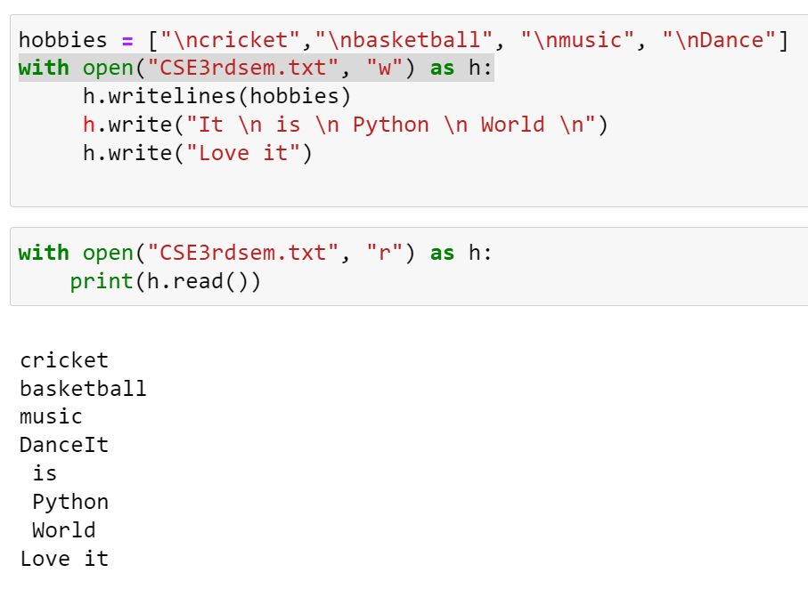
'''
with:
The with statement automatically takes
care of closing the file once
it leaves the with block, even in cases of error.

Slide 14
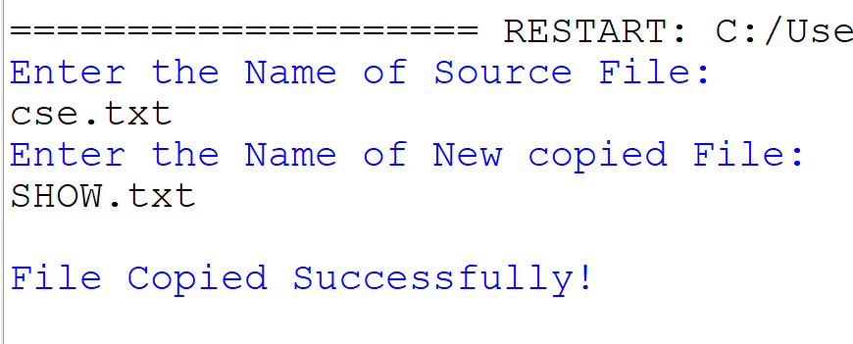
# COPY FILE
print("Enter the Name of Source File: ")
source = input() #cse.txt. must be already created with some contents
print("Enter the Name of New copied File: ")
cfile = input()
f = open(source, "r") #read original file
x = f.readlines()
f.close()
f = open(cfile, "w")
for i in x:
f.write(i) # write already read contents in new file
f.close()
print("\nFile Copied Successfully!")

Slide 15
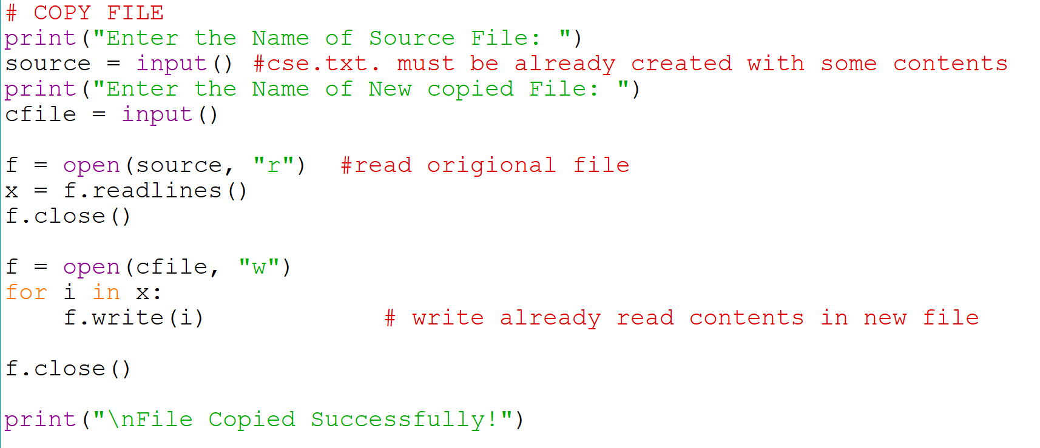

Slide 16
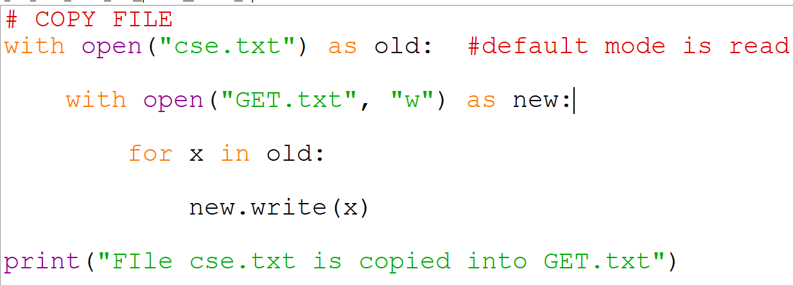

Slide 17
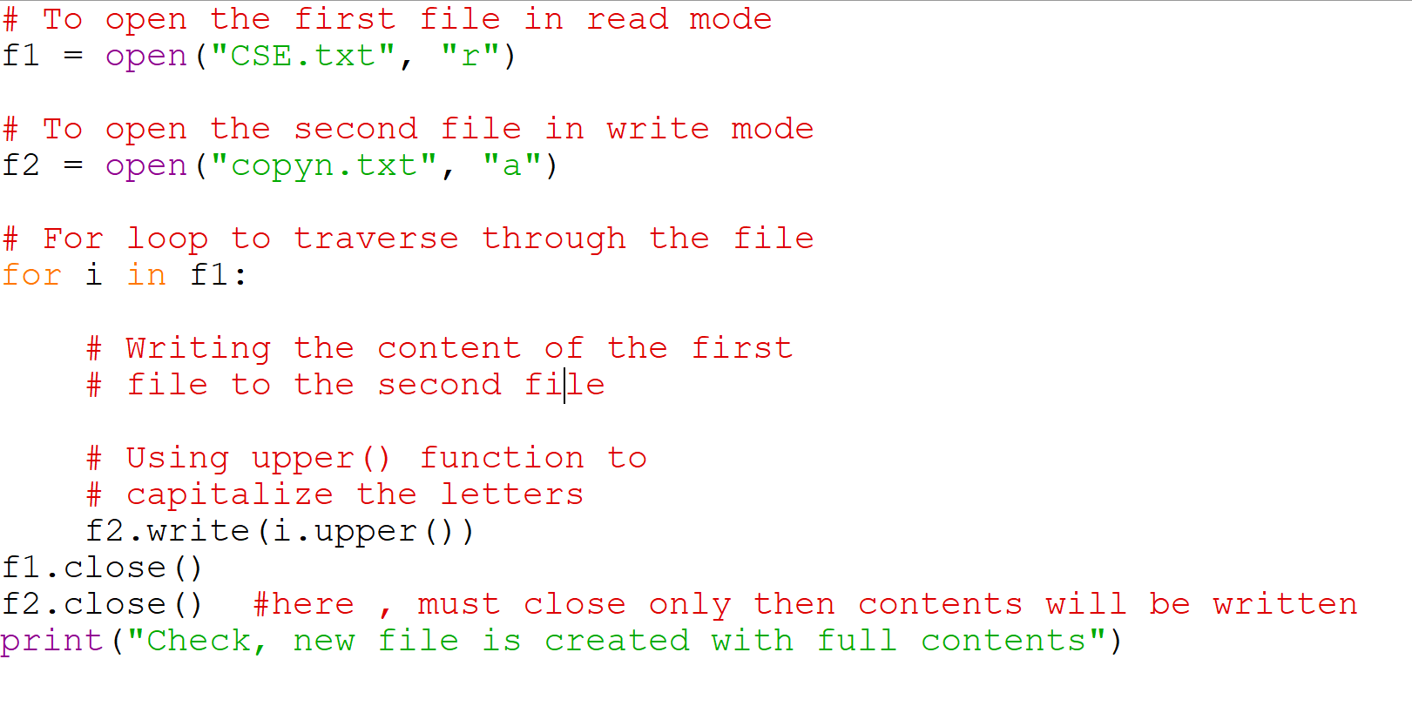
# Copy one file contents into other %%
f1 = open("CSE.txt", "r")
f2 = open("copyn.txt", "a")
for i in f1:
f2.write(i.upper())
f2.close() #here , must close only then contents will be written
print("Check, new file is created with full contents")

Slide 18
TEXT FILES
A text ﬁle with three lines of text separated by newlines
>>> f = open("test.dat","w")
>>> f.write("line one\nline two\nline three\n")
>>> f.close()
The readline method reads all the characters up to and including the next newline character:
>>> f = open("test.dat","r")
>>> print (f.readline())
line one
>>>
readlines returns all of the remaining lines as a list of strings:
>>> print (f.readlines())
[’line two\012’, ’line three\012’]

Slide 19
#code of previous slide
f = open("test.dat","w")
f.write("line one\nline two\nline three\n")
f.close()
f = open("test.dat","r")
print (f.readline()) #only 1st line before \n
print (f.readlines())# rest lines as same open() is continued on test.dat
'''o/p:
line one
['line two\n', 'line three\n']'''

Slide 20
#WRITING VARIABLES IN A FILE
x=500
f = open("test.dat","w")
f.write(str(x))
f.close()
f = open("test.dat")
print(f.read())

Slide 21
DIRECTORIES
If you want to open a ﬁle somewhere else, you have to specify the path to the ﬁle, which is the name of the directory (or folder) where the ﬁle is located:
>>> f = open(“D:/foldername/newfile.txt”,”w”)
>>> f.write(This is the file in new Directory)
This example opens a ﬁle named words that resides in a directory named dict, which resides in share, which resides in usr, which resides in the top-level directory of the system, called /.
You cannot use / as part of a ﬁlename; it is reserved as a delimiter between directory and ﬁlenames.

Slide 22
DELETE A FILE
To delete a file, you must import the OS module, and run its os.remove() function
import os
os.remove(“test.txt")

Slide 23
DELETE FOLDER
To delete an entire folder, use the os.rmdir() method
import os
os.rmdir("myfolder")

Slide 24
PICKLING
As things are written as strings in files.
f = open("test.dat","w")
i.e: f.write ( str([1, 2, 3] ) )
f.write (str(99.6))
Here, problem is: while reading it, we get string.
Original Type information of data is lost.
i.e: f.readline() will results ’ [1, 2, 3]99.6’
Here The solution is pickling.
To get the original data structures back (like lists, dictionaries), use the concept of Pickling. To use it, import pickle and then open the ﬁle in the usual way:
>>> import pickle
>>> f = open("test.pck","wb")
To store a data structure, use the dump method and then close the ﬁle in the usual way:
The dump() method is used when the Python objects have to be stored in a file.
>>> pickle.dump([1,2,3], f)
>>> pickle.dump(99.6, f)
>>> f.close()

Slide 25
PICKLING - CONTINUED
The load() method of Python pickle module reads the pickled byte stream of one or more python objects from a file object.
Then we can open the ﬁle for reading and load the data structures we dumped:
>>> f = open("test.pck","rb")
>>> y = pickle.load(f)
>>> y
[1, 2, 3]
>>> type(y)
<type ’list’>
>>> x = pickle.load(f)
>>> x
99.6
>>> type(x)
<type ’float’>

Slide 26
MORE EXAMPLES ON PICKLE
import pickle as p
f=open("dump.txt","wb")
p.dump(99.6, f)
p.dump(87, f)
f.close()
f=open("dump.txt","rb")
x=p.load(f)
print(x)
x=p.load(f)
print(x)

Slide 27
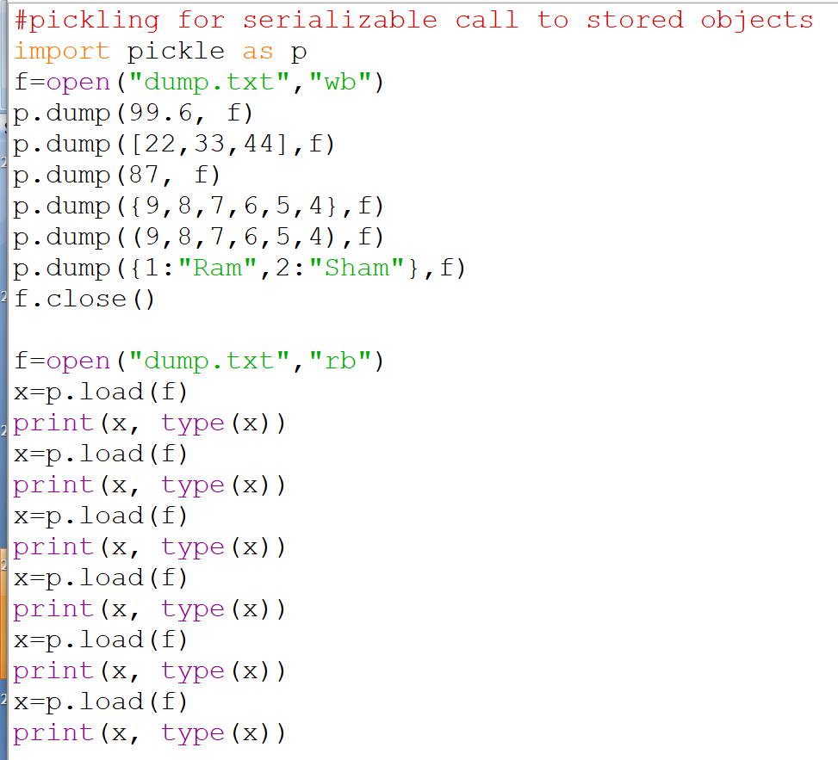
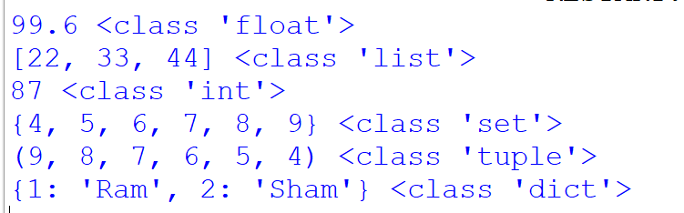

Slide 28
CODE OF ABOVE SLIDE
f=open("dump.txt","rb")
x=p.load(f)
print(x, type(x))
x=p.load(f)
print(x, type(x))
x=p.load(f)
print(x, type(x))
x=p.load(f)
print(x, type(x))
x=p.load(f)
print(x, type(x))
x=p.load(f)
print(x, type(x))
#pickling for serializable call to stored objects
import pickle as p
f=open("dump.txt","wb")
p.dump(99.6, f)
p.dump([22,33,44],f)
p.dump(87, f)
p.dump({9,8,7,6,5,4},f)
p.dump((9,8,7,6,5,4),f)
p.dump({1:"Ram",2:"Sham"},f)
f.close()

Slide 29
EXCEPTIONS
Whenever a runtime error occurs, it creates an exception. Usually, the program stops and Python prints an error message.
For example,
>>> print (55/0)
ZeroDivisionError: integer division or modulo
>>> a = []
>>> print (a[5])
IndexError: list index out of range
>>> b = {}
>>> print (b[’what’])
KeyError: what
>>> f = open("Idontexist", "r")
IOError: [Errno 2] No such file or directory: ’Idontexist’

Slide 30
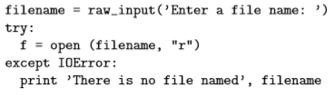
EXCEPTIONS
The error message has two parts: the type of error before the colon, and speciﬁcs about the error after the colon. Sometimes we want to execute an operation that could cause an exception, but we don’t want the program to stop. We can handle the exception using the try and except statements.
The try statement executes the statements in the ﬁrst block. If no exceptions occur, it ignores the except statement. If an exception of type IOError occurs, it executes the statements in the except branch and then continues.

Slide 31
EXCEPTIONS
The raise statement takes two arguments: the exception type and speciﬁc information about the error. ValueError is one of the exception types Python provides for a variety of occasions. Other examples include TypeError, KeyError, and my favorite, NotImplementedError.
If the function that called input Number handles the error, then the program can continue; otherwise, Python prints the error message and exits:

Slide 32
# ValueError is an inbuilt exception to give a message
def number():
x=input("Enter a Value")
if(x=="7777"):
raise ValueError("not good")
else:
print(“I am a Good Value")
number()

Slide 33
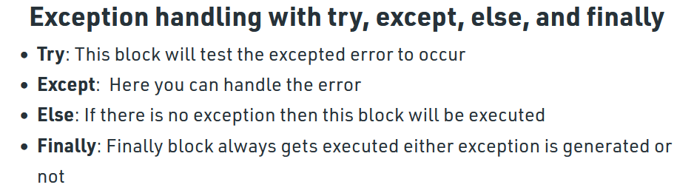
Use of try, except, finally

Slide 34
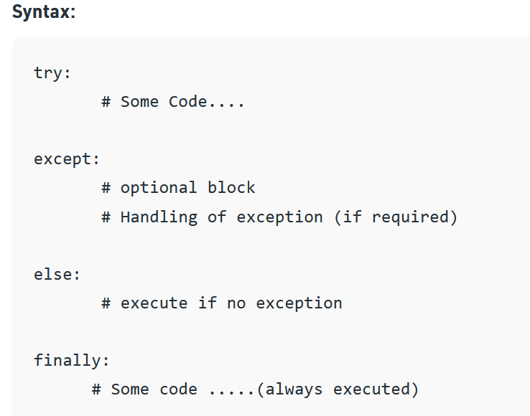

Slide 35
#try except finally:
def divide(x, y):
try:
# Floor Division : Gives only Fractional
result = x // y
print("Your answer is :", result)
except:
print("Sorry ! You are dividing by zero ")
finally:
print("I always appear\n")
# Look at parameters and note the working of Program
divide(3, 2)
divide(3, 0)
Output:
Your answer is : 1
I always appear
Sorry ! You are dividing by zero
I always appear

Slide 36
SOME BUILT-IN EXCEPTIONS
ZeroDivisionError Raised when the second operator in a division is zero
ValueError Raised when there is a wrong value in a specified data type
TypeError Raised when two different types are combined
SyntaxError Raised when a syntax error occurs
ArithmeticError Raised when an error occurs in numeric calculations
Exception Base class for all exceptions
IndentationError Raised when indendation is not correct

Slide 37
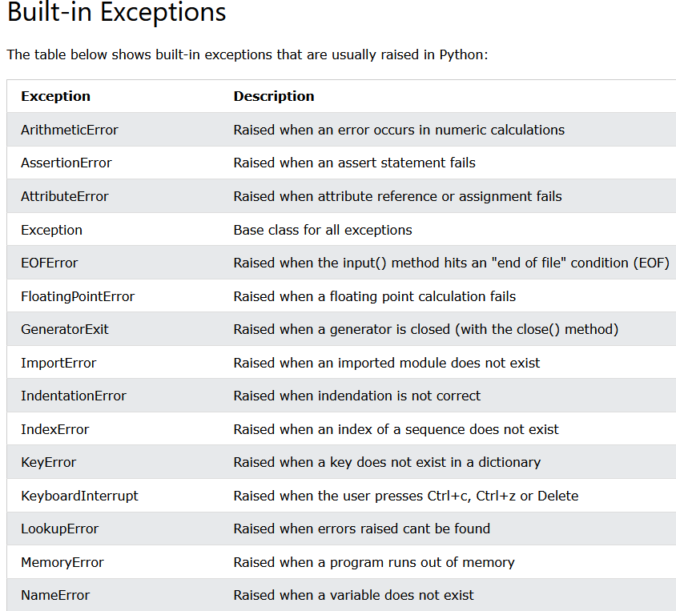


Slide 38
WRITING VARIABLES
To write data types other than string, do (Here x is a value)
>>> x = 52
>>> f.write (str(x))
or use the Format Operator /format specifier (%)
>>> cars = 52
>>>"%d" % cars
’52’
Another example:
>>> cars = 52
>>> "In July we sold %d cars.“ % cars
’In July we sold 52 cars.’

Slide 39
WRITING VARIABLES – FORMAT OPERATOR
%f for floats, %s for strings, %d for decimal values
>>> "In %d days we made %f million %s." % (34,6.1,’dollars’)
’In 34 days we made 6.100000 million dollars.’
>>> "%d %d %d" % (1,2)
TypeError: not enough arguments for format string
>>> "%d" % ’dollars’
TypeError: illegal argument type for built-in operation
For more control over the format of numbers, we can specify the number of digits as part of the format sequence:
>>> "%6d" % 62
’ 62’
>>> "%12f" % 6.1
’ 6.100000’
The number after the percent sign is the minimum number of spaces the number will take up.

Slide 40
WRITING VARIABLES – FORMAT OPERATOR
If the value provided takes fewer digits, leading spaces are added. If the number of spaces is negative, trailing spaces are added:
>>> "%-6d" % 62
’62 ’
For ﬂoating-point numbers, we can also specify the number of digits after the decimal point:
>>> "%12.2f" % 6.1
’ 6.10’

Slide 41
QUESTIONS
1. Write a program that removes all the occurrences of a specified string from a file. Your program should prompt the user to enter a filename and a string to be removed.
2. Write a program that will count number of characters, words and lines in a file.
3. Suppose that a text file contains an unspecified number of scores. Write a program that reads the scores from the file and display their total and average. Scores are separated by blanks. Your program should prompt the user to enter a filename.
4. Write a program that write 100 random integers. Integers are separated by space in file. Read the data back fro the file and display the sorted data.
5. Write the program to replace the text in a file. Your program should prompt the user to enter filename, old string, new string.
6. Write the program that counts the number of characters in a given line http://cs.Armstrong.edu/liang/Data/Lincoln.txt

Slide 42
#Write a program that removes all the occurrences of a specified string from a file. Your program should prompt the user to enter a filename and a string to be removed.
f = open("D:/del.txt", "w")
f.write("Delete all H and i when both are together")
f.write("\nHello Hi PythonHiCSE Hi Hello Hi") # delete all Hi
f.close()
f = open("D:/del.txt", "r")
f1=f.read()
d = f1.replace("Hi","") # No more Hi will be in fi file
print(d)
o/p:Delete all H and i when both are together
Hello PythonCSE Hello

Slide 43
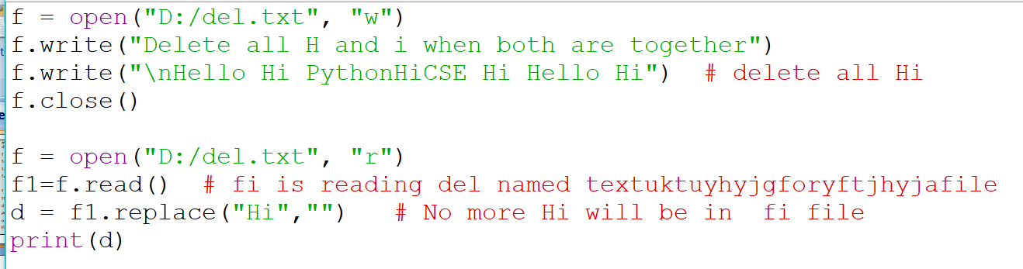

Slide 44
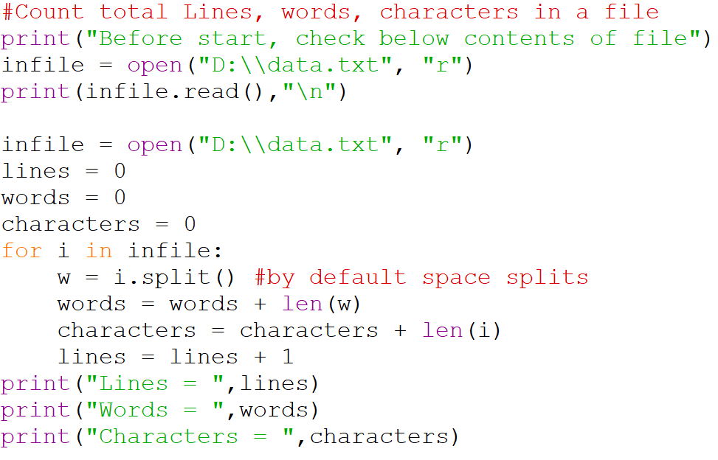

Slide 45
randint(1,2000)
import random
randomlist = []
for i in range(0,5):
  n = random. randint(1,2000)
  randomlist.append(n)
  print(randomlist)

Slide 46
#Store n Random Numbers in a file.
import random
def main():
n =int(input("Enter how many nos: " ))
outfile =open("D:\\nos.txt","w")
for i in range(n): # all nos can be between range 1 to n
outfile.write(str(sorted(random.randint(1,500)))+"\t")
outfile.close()
print("NOW READ below what random nos were saved")
f =open("D:\\nos.txt","r")
print(f.read())
main()
print("OR Check in file at given path , you will get data")

Slide 47
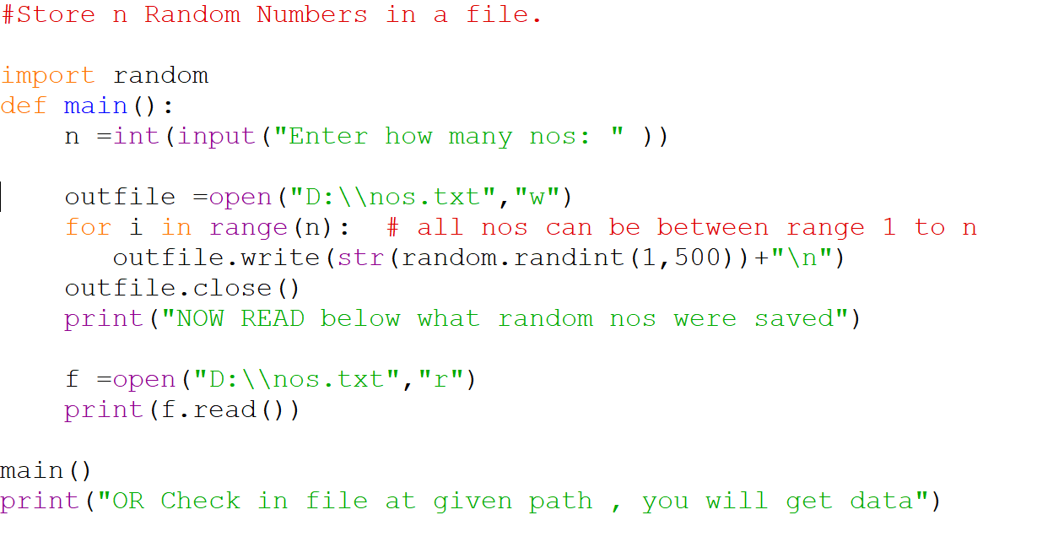
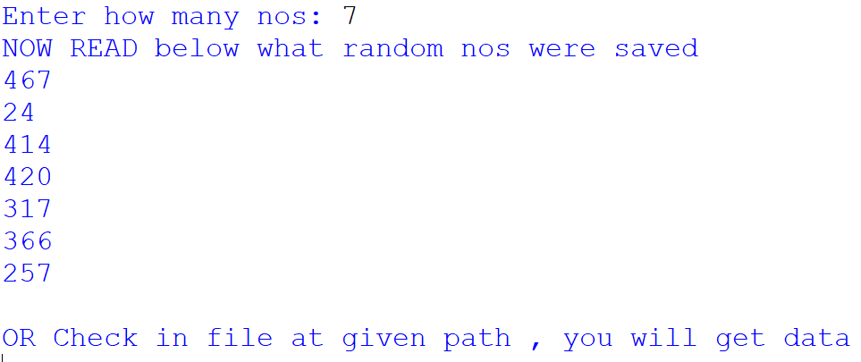
SAME CODE AS ABOVE

Slide 48
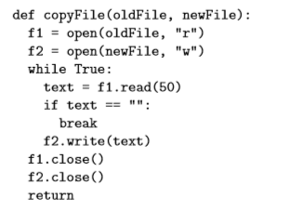
EXAMPLE 1
The following function copies a ﬁle, reading and writing up to ﬁfty characters at a time. The ﬁrst argument is the name of the original ﬁle; the second is the name of the new ﬁle
oldfile=“file.txt”
Newfile=“new.txt”

Slide 49
#COPY one file to another
def cop(old,new):
f1=open("cse.txt", "r")
f2=open("new.txt", "w")
while True:
x=f1.read()
if x=="":
break
f2.write(x)
f1.close()
f2.close()
cop("cse.txt","new.txt")

Slide 50
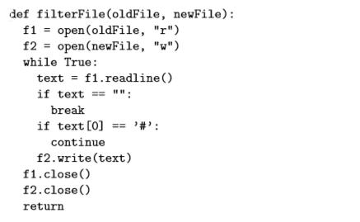
EXAMPLE 2
The following is an example of a line-processing program. filterFile makes a copy of oldFile, omitting any lines that begin with #:

Slide 51
#COPY file cse to new
f=open("cse.txt", "r")
p=open("new.txt", "w")
p.write( f.read() )

Slide 52
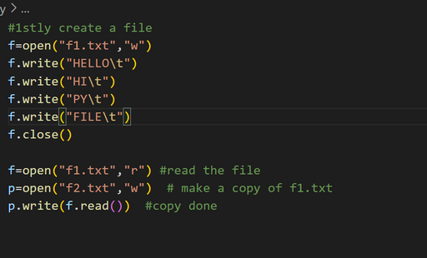
COPY

Slide 53
Write the program to replace the text in a file. Your program should prompt the user to enter filename, old string, new string.
Hint: Can Use replace function
replace(old string, new string)

Slide 54
Write a program that removes all the occurrences of a specified string from a file.
Your program should prompt the user to enter a filename and a string to be removed.
E.g: “Hi Hello Hi Hru Hi I am Fine” in a file. Delete “Hi” from it
Hint replace (“Hi”, “”)

Slide 55
PROGRAM
To open a file and write in it, then count total vowels, consonants, upper, lower

Slide 56
PROGRAM
13 # Implement a stack using list
Hint:
list.append(x)
y=len(list)
for i in range (y,0,-1):
list.pop())

Slide 57
list=[]
n=int(input("How many Values to push"))
for i in range (n):
x=int(input("Enter Value to push"))
list.append(x)
y=len(list)
print("Total elements pushed in list are = ", y)
print("Stack of elements is", list)
for i in range (y,0,-1):
print("popped element is:",list.pop())
print("Pending elements in Stack are", len(list),"and stack is",list)

